Slide 1




Secure and manage your data in Microsoft Teams
Jasper Oosterveld

Slide 2
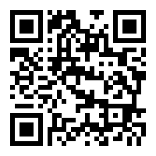
Code of Conduct
As event and experience organizers, we seek to provide a respectful, friendly, professional experience for everyone, regardless of gender, sexual orientation, physical appearance, disability, age, race or religion.
We do not tolerate any behavior that is degrading to any gender, race, sexual orientation, or disability, or any behavior that would be deemed harassment or discrimination.
Individuals are responsible for knowing and abiding by our standards and we encourage everyone to assist in creating a welcoming and safe environment. Please report any concerns, suspicious or disruptive activity or behavior to the organizing team, so that we can address the issue immediately.
More information can be found on the CollabDays Belgium & Netherlands website at https://www.collabdays.org/2021-benl/about

Slide 3
























Our Platinum Sponsors
Community Sponsor
Our Gold Sponsors

Slide 4

About me
00
Introduction
Job
Modern Workplace Consultant & Microsoft MVP
Employer
InSpark
Focus areas
Collaboration, communication, compliance, adoption and governance.
Twitter
@jasoosterveld
LinkedIn
https://www.linkedin.com/in/jasperoosterveld/

Slide 5
01
Welcome to
A brief introduction & business value for Microsoft Teams.
Microsoft
Teams

Slide 6





Hub for collaboration & communication
01
Welcome to Microsoft Teams
Chats
Meetings
Apps &
workflows
Calling
Collaboration

Slide 7




Business value
01
Welcome to Microsoft Teams
Central & integrated work experience
Increase productivity
Accelerate digital transformation
Compliant & secure

Slide 8
Customer worries
01
Welcome to Microsoft Teams
Teams' explosion
Duplication
Purpose unclear
Findability
Complexity
Security & compliance (e.g. data leak)

Slide 9
02
Microsoft
The importance of a Microsoft Teams governance strategy.
Teams
Governance

Slide 10
Importance of a successful governance strategy
02
Microsoft Teams Governance Strategy
Connecting IT & Business.
Contribute to a successful adoption.
Internal procedures & regulations.
Manage Microsoft 365 Groups.

Slide 11
Step 1: Governance workshop
02
Microsoft Teams Governance Strategy
Scope
Vision & goals
Steering committee
Roles & responsibilities
Collaboration templates & requirements
Microsoft Teams policies & settings
Processes & procedures
New features & updates

Slide 12
Step 2: Finalize governance strategy
02
Microsoft Teams Governance Strategy
Get an agreement on all the topics.
Add these into a document.
Present findings.
Finalize your governance strategy.

Slide 13
Step 3: Governance implementation
02
Microsoft Teams Governance Strategy
Configure your Microsoft Teams policies & settings.
Implement a governance solution (for example: Provisioning solution)

Slide 14
03
Compliance
An introduction to the importance of a compliance strategy & implementation.
Strategy &
Implementation

Slide 15
Trends
03
Compliance strategy & implementation
Data is exploding! 10x amount of data created and stored by 2025 (vs. 2016).
The regulatory landscape is complex and shifting​.
COVID-19 caused an explosion in the usage of Microsoft Teams.

Slide 16
Challenges
03
Compliance strategy & implementation
88% of organizations no longer have confidence to detect and prevent loss of sensitive data.
>80% of corporate data is “dark” – it’s not classified, protected or governed.
#1 Protecting and governing sensitive data is biggest concern in complying with regulations.
Source
Forrester. Security Concerns, Approaches and Technology Adoption. December 2018
IBM. Future of Cognitive Computing. November 2015
Microsoft GDPR research, 2017

Slide 17
Real world examples
03
Compliance strategy & implementation
"OLVG receives fine of 440,000 euros for unlawful access to sensitive information".
"Over 100,000 resumes illegally downloaded at UWV“.
Personal data of 65,000 civil servants on the street due to data leak at ministry.
Private addresses of MPs on the street due to Chamber of Commerce data breach.

Slide 18
Important questions
03
Compliance strategy & implementation
Do you know where your business critical and sensitive data resides and what is being done with it?
Do you have control of this data as it travels inside and outside of your organization?
Are you using multiple solutions to classify, label, and protect this data?

Slide 19
04
Microsoft
Microsoft Information Protection
Information
Protection

Slide 20
Microsoft Information Protection
04
Microsoft Information Protection
Broad coverage

Slide 21
Information classification policy
04
Microsoft Information Protection
Personal
Public
Internal
Confidential
Strictly Confidential
Non-business data, for personal use only.
Company data specifically prepared and approved for public use.
Company data intended for general use within and outside the organization (business partners).
Sensitive company data that damages the company if it is shared with unauthorized people.
Highly sensitive company data that causes damage to the company if it is shared with unauthorized people.

Slide 22
Information protection policy
04
Microsoft Information Protection
“Non-business data, for personal use only.”
No protection
Personal
“Company data specifically prepared and approved for public use.”
No protection
Public
“Company data intended for general use within and outside the organization (business partners).”
No protection
Internal

Slide 23
Information protection policy
04
Microsoft Information Protection
“Sensitive company data that damages the company if it is shared with unauthorized people.”
Security: Accessible for all Contoso employees (internal) & for authorized persons (external).
Footer: Classification: Confidential or Classification: Confidential External.
Example: HR
Confidential
“Highly sensitive company data that causes damage to the company if it is shared with unauthorized people.”
Security: Accessible to authorized people per department.
Footer: Classification: Very Confidential or Classification: Very Confidential External.
Watermark: Strictly confidential
Example: Board of Directors
Strictly confidential

Slide 24
05
Sensitivity
Working with sensitivity labels & Microsoft Teams
labels & MS
Teams

Slide 25
Sensitivity labels: What?
05
Sensitivity labels & MS Teams
Labels to classify & protect information (for example: Office files & PDF).
Labels to classify teams in Microsoft Teams.

Slide 26
Sensitivity labels: Why?
05
Sensitivity labels & MS Teams
Content
Labels protect sensitive content from unauthorized users by applying encryption.
The encryption continues to work regardless of the location of the content.
Microsoft Teams
Enforcing governance agreements: Default privacy setting, enable or disable guest access, type of external sharing links and type of access with unmanaged devices.

Slide 27
Sensitivity labels: How?
05
Sensitivity labels & MS Teams
Labels are applied manually or automatically (E5).

Slide 28
Examples
05
Sensitivity labels & MS Teams
Sensitivity labels & content

Slide 29
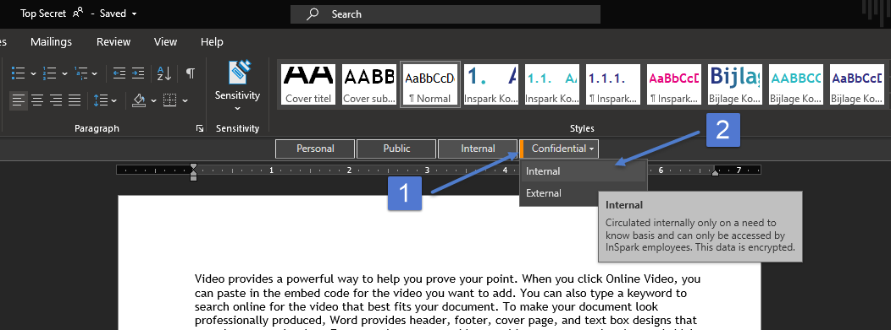
Manually apply a label
05
Sensitivity labels & MS Teams

Slide 30
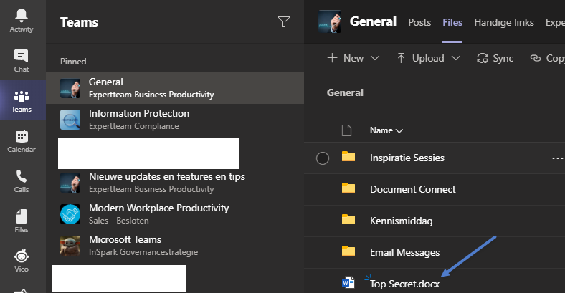
Save the file in Teams
05
Sensitivity labels & MS Teams

Slide 31
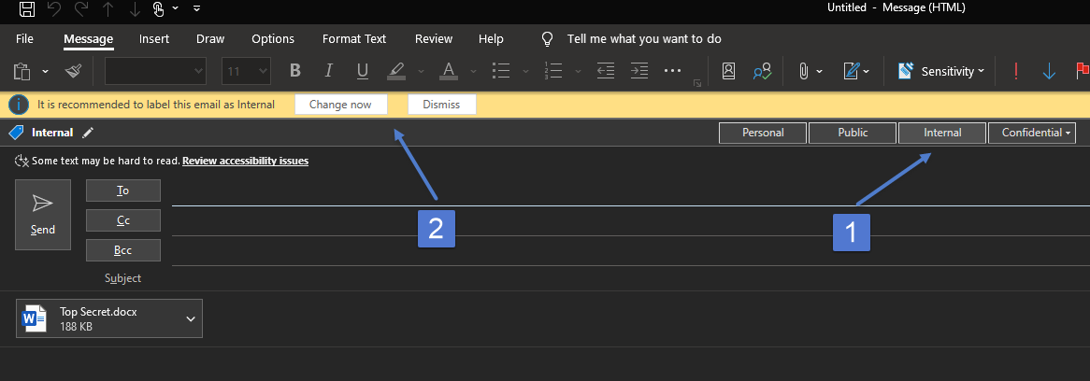
Sensitivity labels: E-mail the file
05
Sensitivity labels & MS Teams

Slide 32
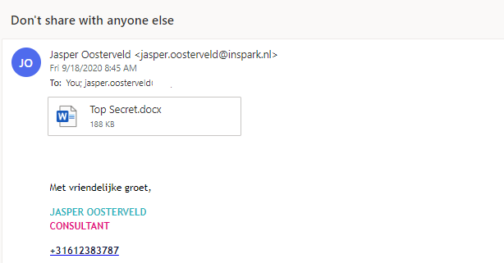
Sent to an unauthorized person
05
Sensitivity labels & MS Teams

Slide 33
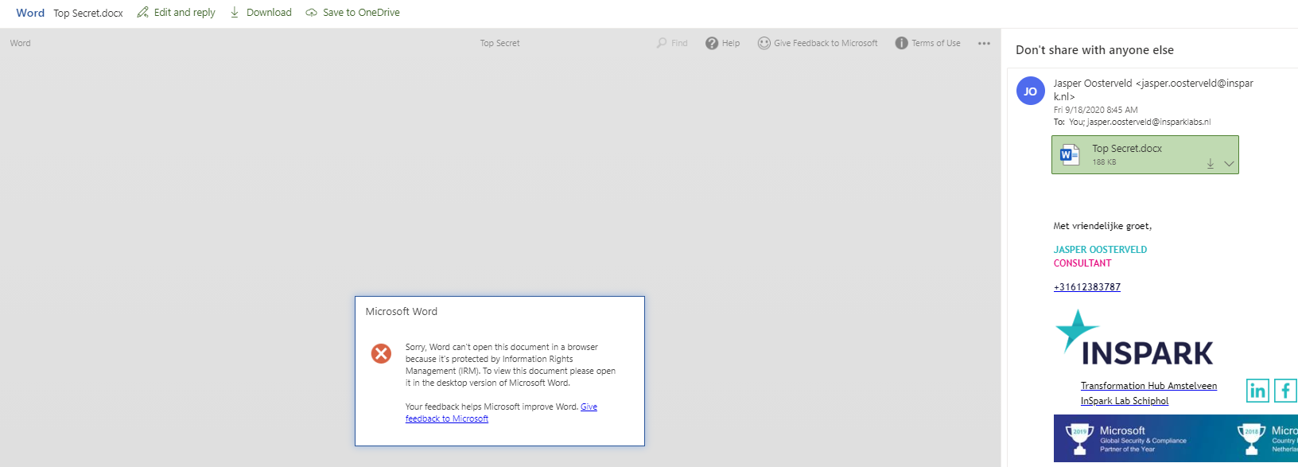
Unauthorized person tries to open the file
05
Sensitivity labels & MS Teams

Slide 34
Examples
05
Sensitivity labels & MS Teams
Sensitivity labels & Microsoft Teams

Slide 35
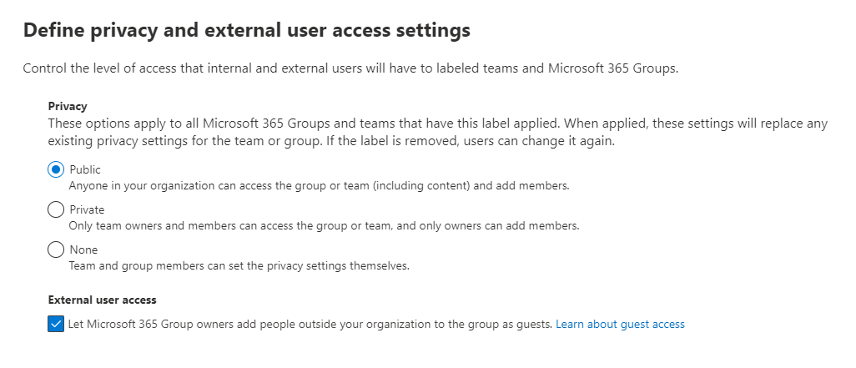
Define privacy and external user access settings (1)
05
Sensitivity labels & MS Teams

Slide 36
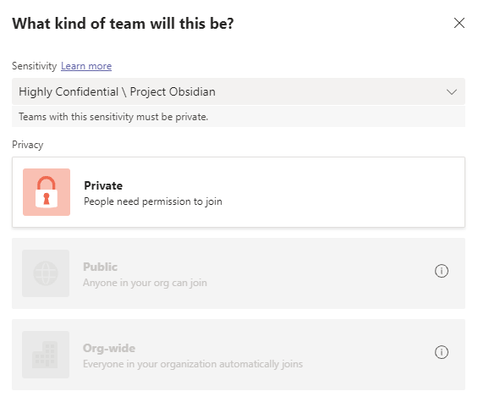
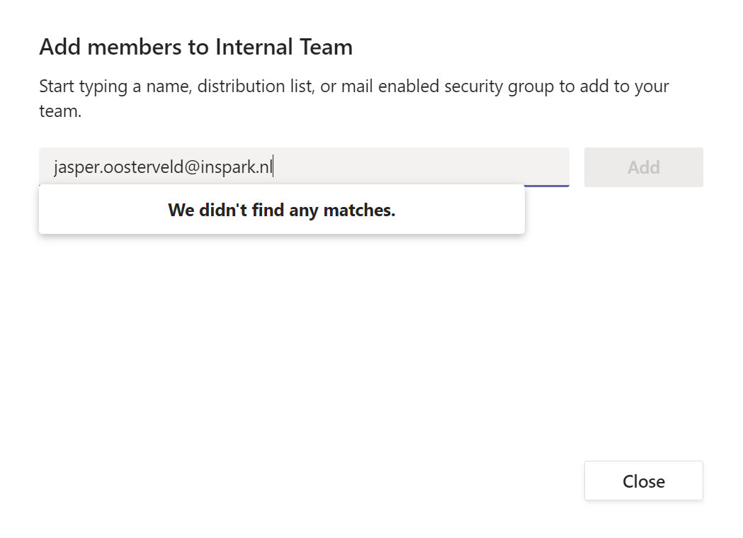
Define privacy and external user access settings (2)
05
Sensitivity labels & MS Teams

Slide 37
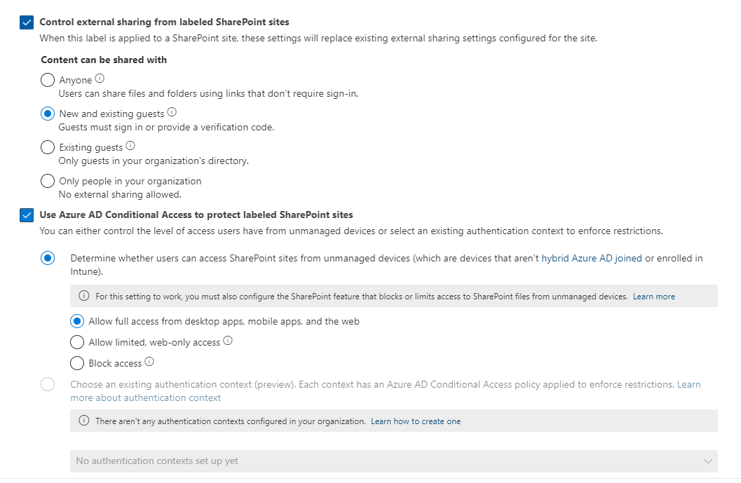
Define external sharing and device access settings (1)
05
Sensitivity labels & MS Teams

Slide 38
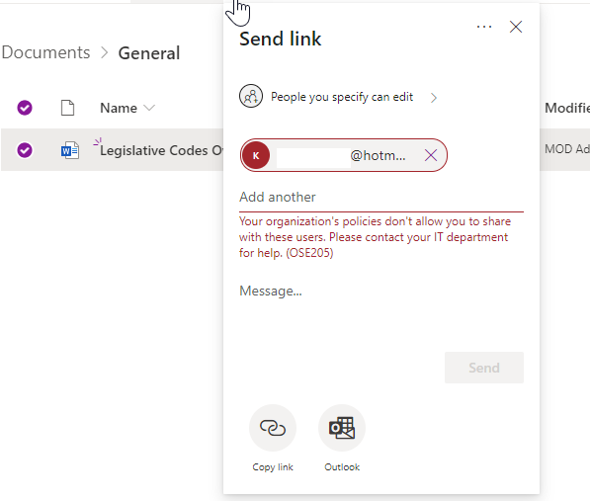
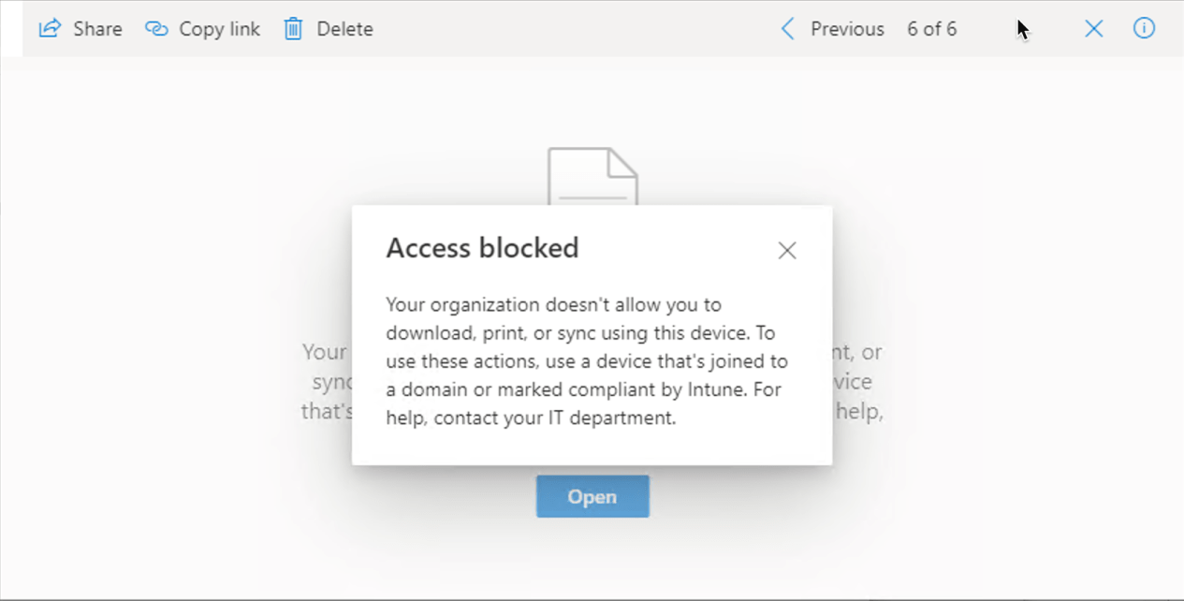
Define external sharing and device access settings (2)
05
Sensitivity labels & MS Teams

Slide 39
06
Data
Data Loss Prevention & Microsoft Teams
Loss
Prevention

Slide 40
DLP: What?
06
DLP & MS Teams
A policy aimed at identifying and automatically protecting sensitive information.

Slide 41
DLP: Why?
06
DLP & MS Teams
Prevent the conscious or unconscious sharing of sensitive information with colleagues and/or external persons.

Slide 42
DLP: How?
06
DLP & MS Teams
The author receives a notification if a policy is detected.
The content is blocked from colleagues and/or external persons.
The content is only available to the owner, site administrator and the employee who last modified it.
A notification is sent to one or more employees (Pick the: CISO!)
Optional: The author ignores the policy and/or files an objection.

Slide 43
Examples
06
DLP & MS Teams
DLP & Microsoft Teams

Slide 44
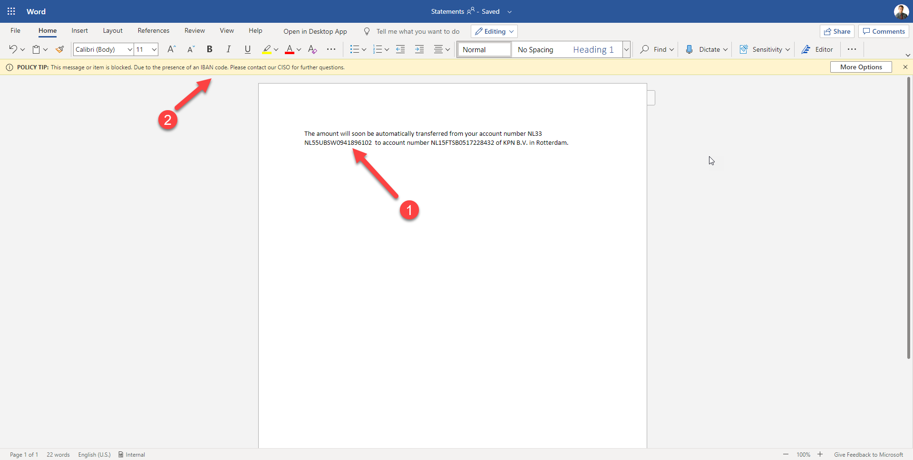
Office Online
06
DLP & MS Teams
IBAN number

Slide 45
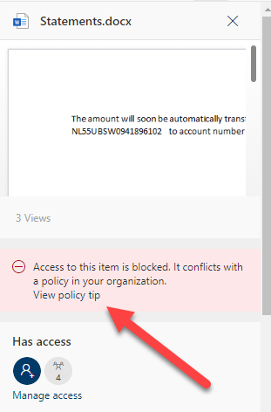
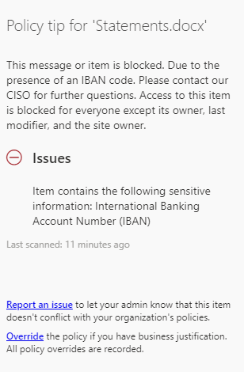
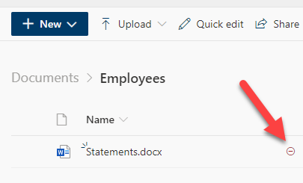
SharePoint Online
06
DLP & MS Teams

Slide 46
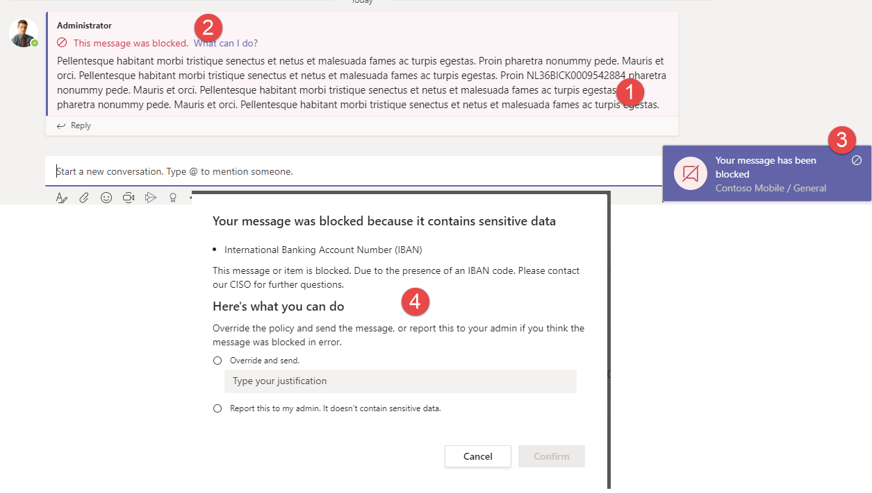
Teams & chat (E5)
06
DLP & MS Teams

Slide 47
07
External
Controlling external access while working with Microsoft Teams
Access &
MS Teams

Slide 48
Risks
07
External access & Microsoft Teams
Guests get access to the content of all the standard channels.
Guests can download and leak sensitivity information.

Slide 49
Important!
07
External access & Microsoft Teams
Define your internal policies for inviting and working with guests in Microsoft Teams.

Slide 50
Managing the risks
07
External access & Microsoft Teams
Apply MFA for guests.
Apply sensitivity labels & DLP to protect sensitive content.
Apply Conditional Access for unmanaged devices.

Slide 51
Managing guests
07
External access & Microsoft Teams
Guest access
Block or allow specific domains
Allow specific teams (with sensitivity labels)
Sharing links:
Allow or block.
Type of link (new & existing guests or existing guests)
Guest review:
Azure Access Reviews (Azure AD P2)
Custom solution (for example: blog.atwork.at | Groups Governance Toolkit Part 5-External Guests).
3rd party solution (for example: ShareGate Apricot).

Slide 52
08
Retention
Retaining your data while working with Microsoft Teams
of your data in
MS Teams

Slide 53
Retention: What?
08
Retention & information governance
Govern your data for compliance or regulatory requirements.
Determined by the laws and regulations related to your organization.

Slide 54
Options
08
Retention & information governance
Retain content for a specified period (days, months & years).
OR
Retain & automatically delete content after a specified period (days, months & years).
OR
Automatically delete content after a specified period (days, months & years).

Slide 55
Retention: How
08
Retention & information governance
Retention Policies
Retention Labels
Record Management

Slide 56
Examples
08
Retention & MS Teams
Retention & Microsoft Teams

Slide 57
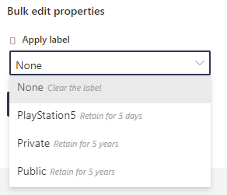
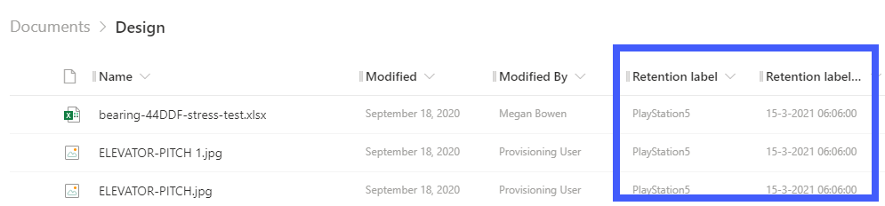
Label & SharePoint
08
Retention & information governance

Slide 58
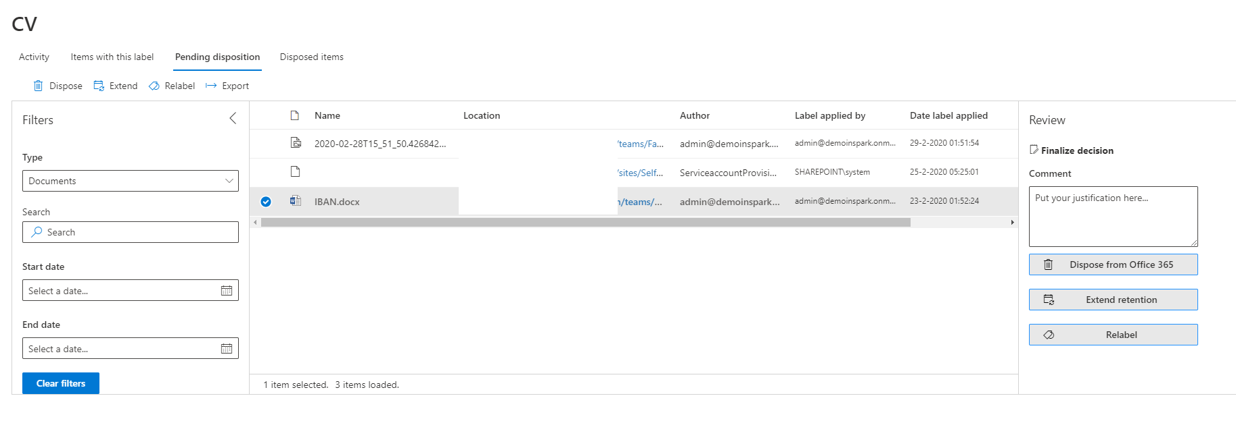
Disposition review
08
Retention & information governance

Slide 59
09
Conclusion
Let’s wrap things up!
of this
presentation

Slide 60
Tips & tricks
09
Conclusion
Match regulations and internal procedures with the usage of Microsoft Teams.
Test! Test! Test!
Educate & inform your employees.

Slide 61
About me
00
Introduction
Job
Modern Workplace Consultant & Microsoft MVP
Employer
InSpark.
Focus areas
Collaboration, communication, compliance, adoption and governance.
Twitter
@jasoosterveld
LinkedIn
https://www.linkedin.com/in/jasperoosterveld/

Slide 62
Resources – Information Protection
09
Conclusion
Microsoft Information Protection in Microsoft 365
Learn about sensitivity labels
Microsoft Information Protection Yammer Network
Apply a sensitivity label to content automatically
Common scenarios for sensitivity labels
Microsoft Information Protection SDK
View label usage with label analytics
Scoping Office 365 Sensitivity Labels
Blog Joanne C Klein

Slide 63
Resources – DLP
09
Conclusion
Overview of data loss prevention
Create a custom sensitive information type in the Security & Compliance Center
Sensitive information type entity definitions
Data loss prevention and Microsoft Teams

Slide 64
Resources – Information Governance
09
Conclusion
Learn about retention for Microsoft Teams
Learn about retention policies and retention labels
Learn about retention for SharePoint and OneDrive
Learn about records management in Microsoft 365
Using Trainable Classifiers to Assign Office 365 Retention Labels
View label usage with label analytics

Slide 65



